Slide 1
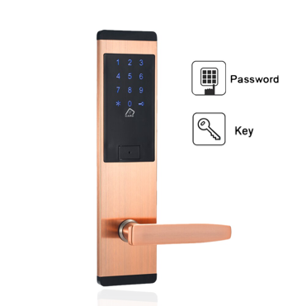


Electronic Safety Lock
Edoardo Panichi – ID 1856156
Giulio Rosadi – ID 1856156
edoardo.panichi@studio.unibo.it
giulio.rosadi@studio.unibo.it

Slide 2

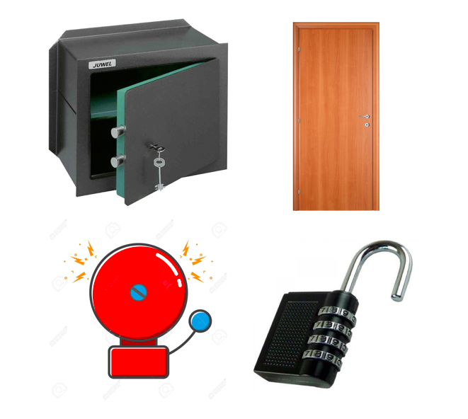

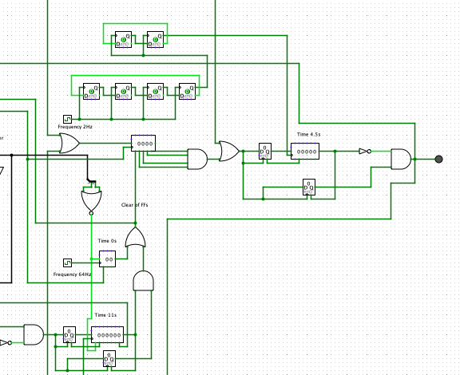
Motivations of the Project
Daily Use
Multiple Application
Safety Reasons
Challenging

Slide 3
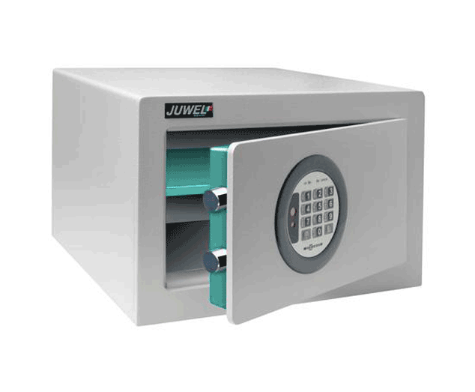
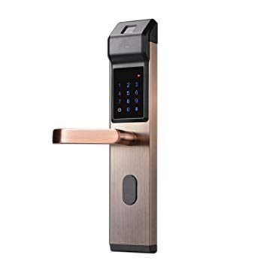

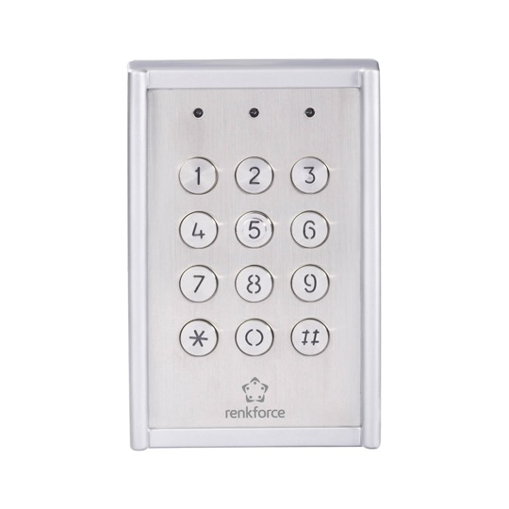
Multiple Applications

Slide 4

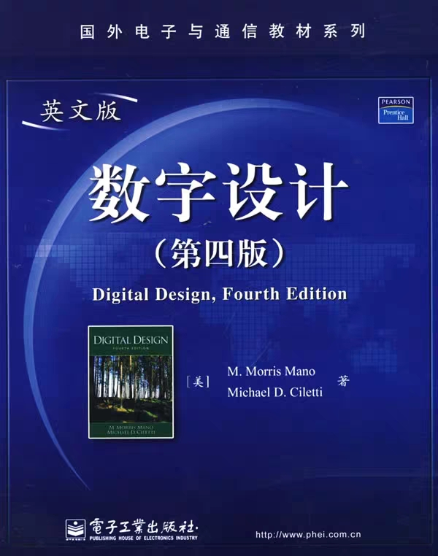
Used Resources
Digital Design - Morris Mano, Ciletti
Logisim

Slide 5

Our Circuit

Slide 6
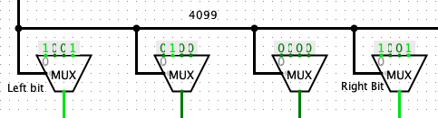
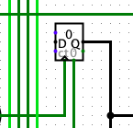
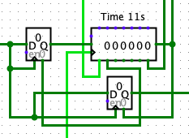
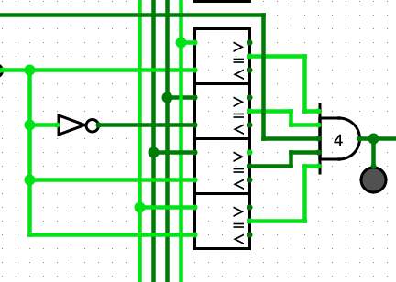
Key-Parts
Multiplexers
Counter
Shift Register
Comparators

Slide 7

Safe
User Friendly
Versatile

Slide 8
THE END
Edoardo Panichi – ID 1856156
Giulio Rosadi – ID 1856156
edoardo.panichi@studio.unibo.it
giulio.rosadi@studio.unibo.it

